Slide 1
British Airways
Predictive model OF CUSTOMER BUYING BEHAVIOUR
27-11-2023

Slide 2
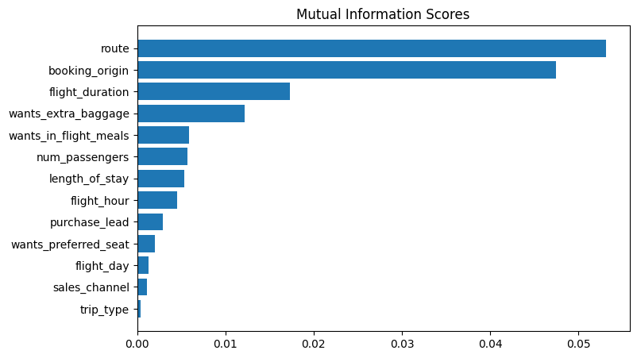
Predictive modelling results using Random Forests
AUC is the probability that the model ranks a random positive example more highly than a random negative example.
AUC
0.57%
Accuracy is the fraction of predictions the model got right.
Accuracy
85.1%
Top features that can drive successful flight bookings.

